Slide 1
Big Data Analytics for Healthcare Industry Project Review - 2
Team Members:
Angelina RC – 2320030428
Vaishnavi A - 2320030450
LakshmiPriya K - 2320030453
Mahati M – 2320030401
Guide: Mr. Venkateswara K

Slide 2
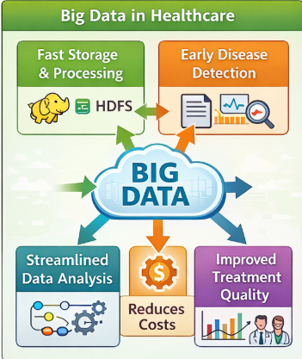
Introduction & Motivation
Heart disease is one of the leading causes of death worldwide. Early prediction of heart disease risk is crucial for timely medical intervention. However, traditional healthcare systems are not capable of efficiently analyzing large and complex datasets to identify risk patterns.
There is a need for a scalable system that can process large volumes of healthcare data and provide accurate predictions for heart disease risk.

Slide 3
Objectives
To analyze large healthcare datasets related to heart disease
To build a predictive model for heart disease risk
To use big data technologies for efficient data processing
Provide decision support for healthcare professionals

Slide 4
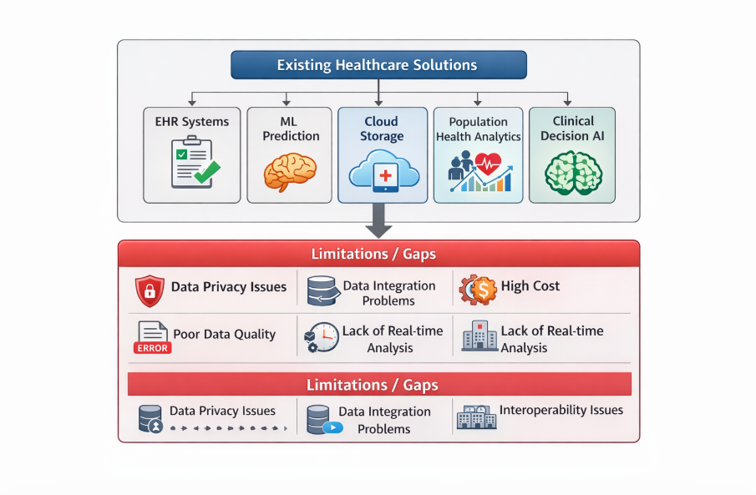
Literature Survey

Slide 5
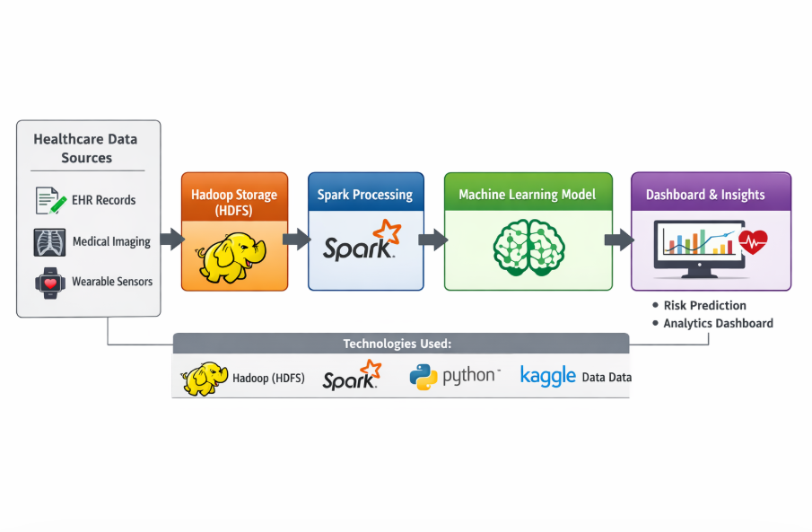
Proposed Methodology
Data Collection from healthcare datasets (Kaggle)
Storage using Hadoop (HDFS)
Processing using Apache Spark
Prediction using Machine Learning (Python)
Visualization using Dashboard

Slide 6
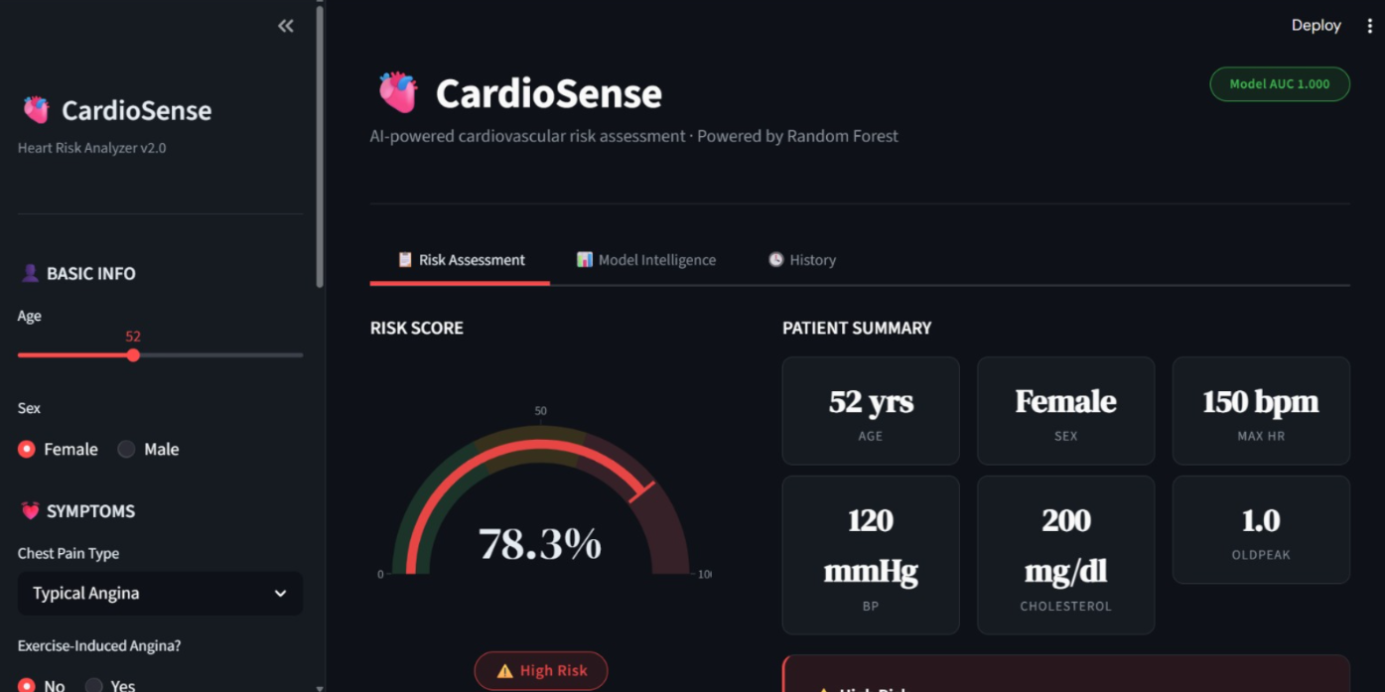
Results

Slide 7
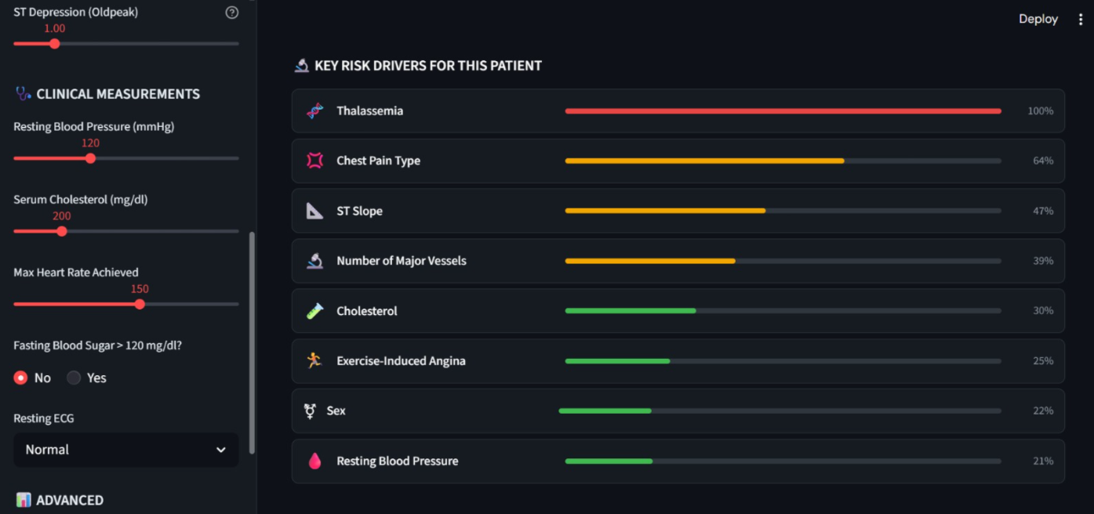

Slide 8
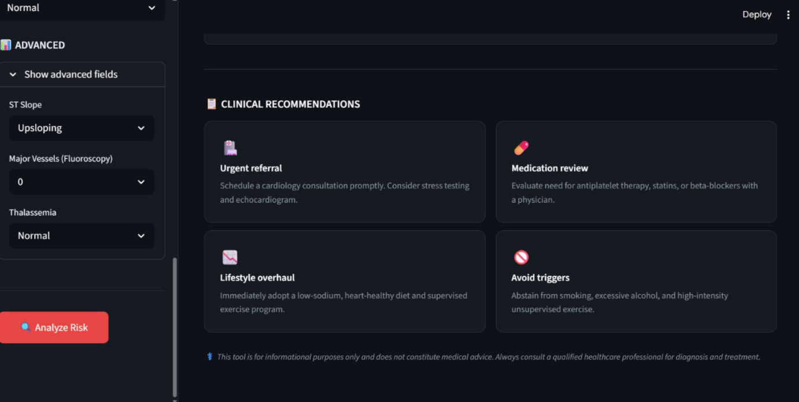

Slide 9
References
IEEE Paper
Big Data Analytics for Healthcare
The Use of Big Data Analytics in Healthcare – Journal of Big Data
Journal Article
Big Data Analytics in Healthcare: Data Sources, Tools, Challenges (2024)
Reference

